Slide 1
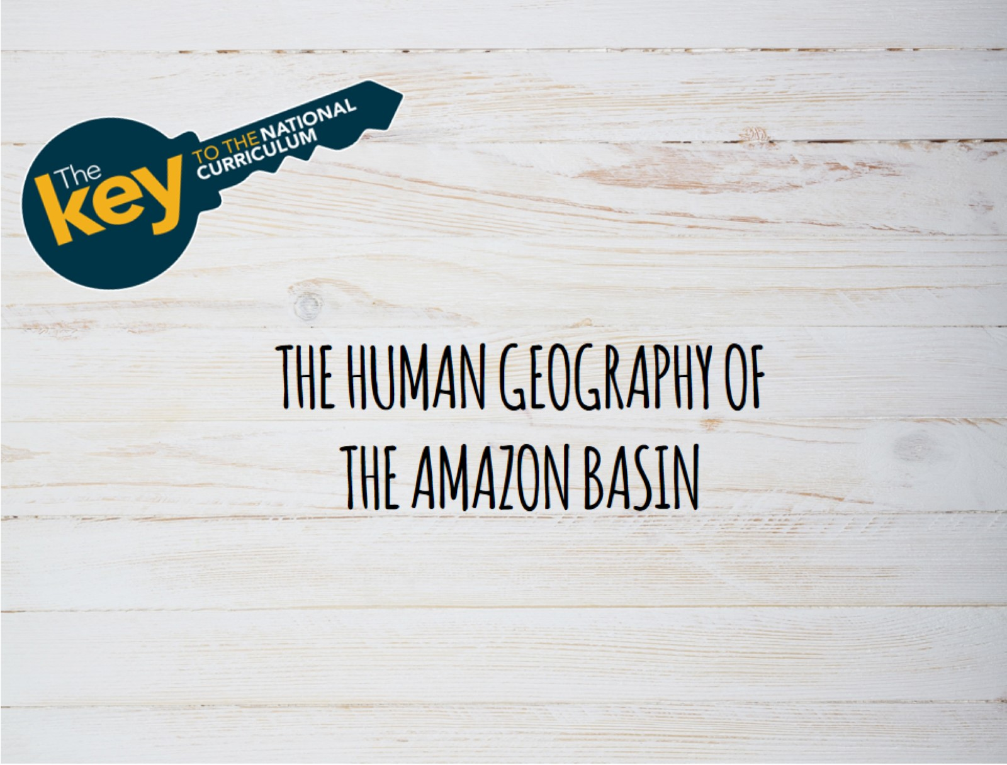

Slide 2
Notes:
Manaus, the capital of Amazonia, is a major river port with many docks, wharves, landings and jetties.
The boat services are international, regional and local. There is much river traffic, the river boats in the photograph are drawn up alongside the busy Manaus market. People can be seen head loading produce from the market onto the boats. These are the boats that transport people and goods to villages and trading posts in Amazonia.
Large ocean going container ships have to anchor off shore. Manaus also acts as ferry port transferring people, vehicles (including very large lorries) and goods across the Rio Negro and Solimoes voyages of up to 15 miles.

Slide 4
Notes:
Four major topographical regions can be recognised in California: the Coastal Ranges, the Central Valley, the Sierra Nevada mountains and the desert areas in south east. The volcanoes Mt Shasta and Mt Lassen are indicated. The highest mountain in the continental USA is Mt Whitney rising to 4421 m (14,505 ft) and is located in the southern Sierra Nevada.

Slide 6
Notes:
The World War II sites, including the Normandy beaches attract many visitors every year.

Slide 8
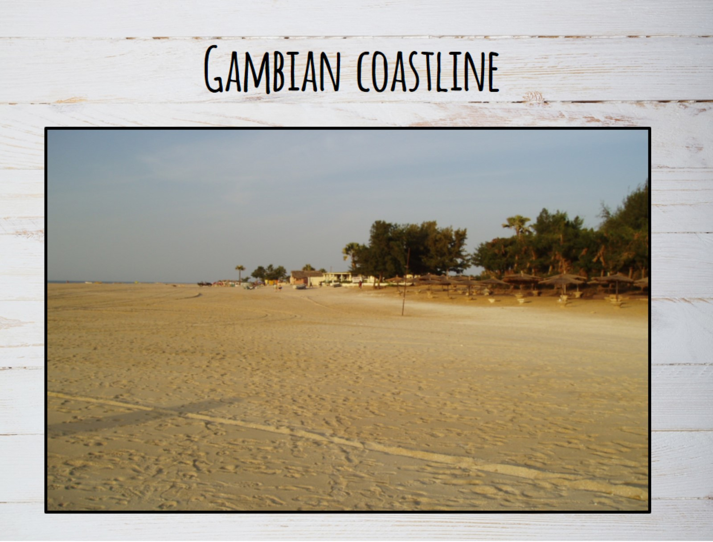
Notes:
The Gambia has an Atlantic coastline with white sandy beaches. The highest altitude in the country is only 174 m above sea level. The tropical climate (hot dry season and hot wet season) has helped produce the savanna landscape.

Slide 9
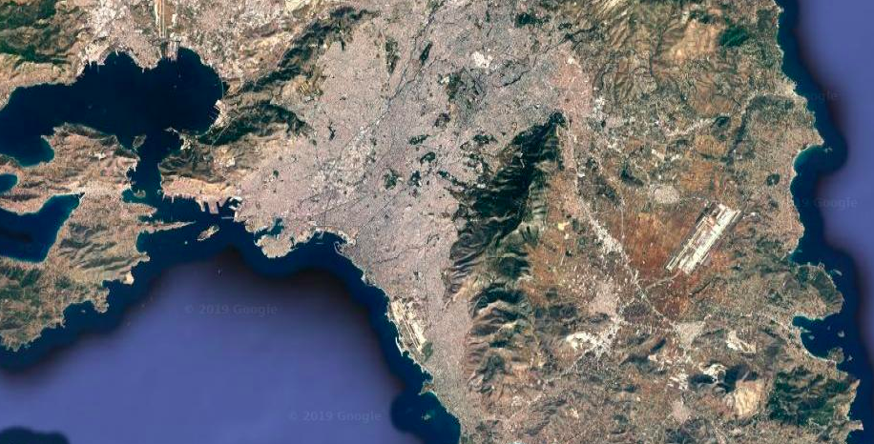
Mt Aigaleo
Pireaus
Acropolis
Mount Hymettus
Airport
Syntagma Square
Lycebettus
Notes:
Athens is located in a basin (of the River IIlisos), and surrounded by hills. Within the basin are isolated hills rising above the general level like the Acropolis.

